Slide 2
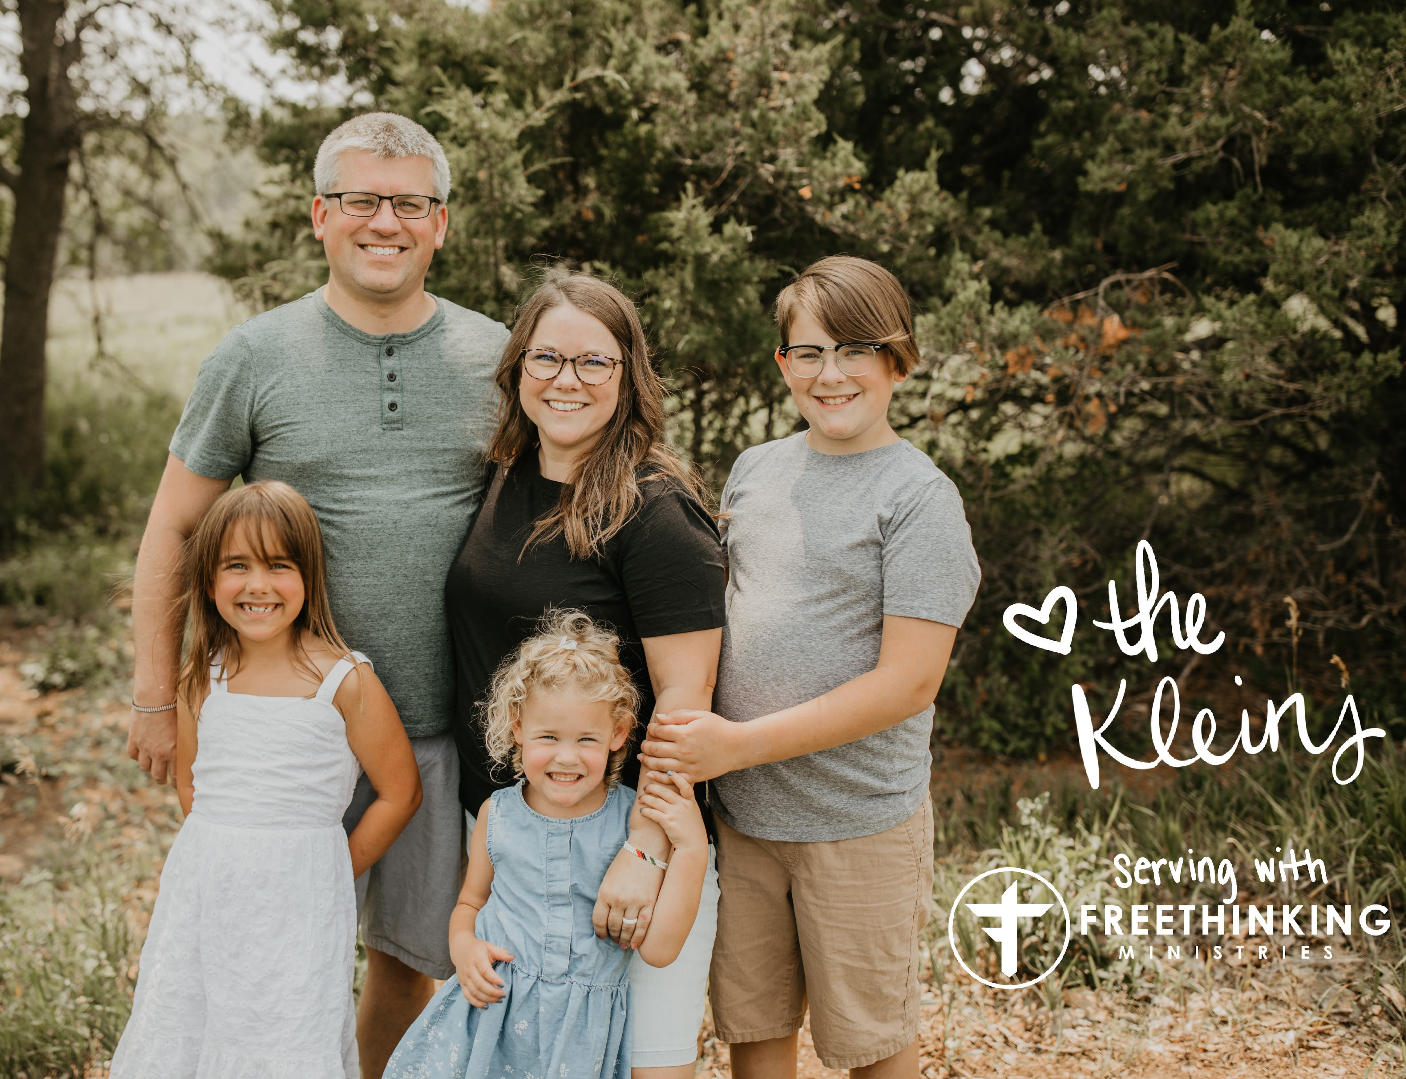

Slide 3
Cultural Conversations

Slide 4
Social Conversations

Slide 5
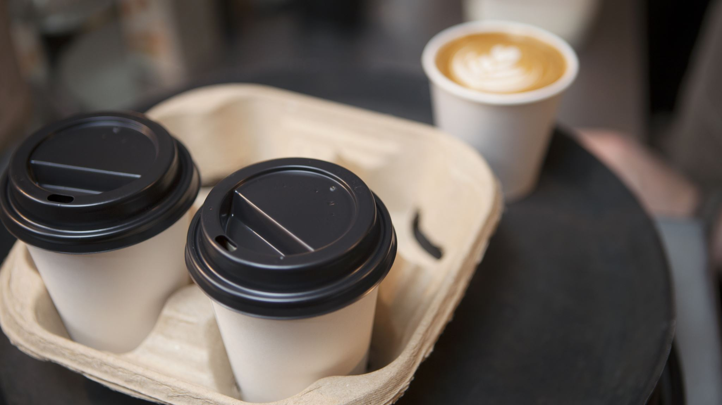
Personal Conversations

Slide 6
So What Then?

Slide 8
Love is
thinking of someone more than yourself
based on the truth of objective reality.

Slide 9
Questions?

Slide 10
Thank You!
If you would like to follow along with what FreeThinking Ministries is doing please do so online or on Twitter (X), Instagram or YouTube!
If you feel led to become partners with our ministry, please do not hesitate to reach out and do so online at https://freethinkingministries.com/donate/ and be sure to put Josh Klein in the comments so we know where you came from! Thank you so much and God Bless!

